Slide 1


SUPERSTORE
BY: Hesham Mahmoud Ahmad
heshammahmoud.data@gmail.com

Slide 2

CONTENT
01
Dataset Summary
02
Preprocessing Steps
03
SQL Insights
04
Dashboard

Slide 3
DATASET SUMMARY
About the Dataset:
  Source: US Superstore Sales data.
  Size: 10,000
  Source: Kaggle
  Features:
    Order Information: Order ID, Order Date, Ship Date.
    Customer Info: Name, Segment, Region.
    Product Info: Category, Sub-Category, Product Name.
    Metrics: Sales, Quantity, Discount, Profit.

Slide 4
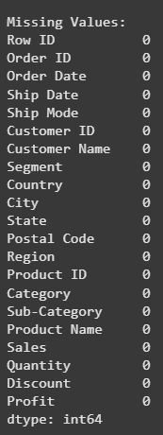

PreprocesSING STEPS
Data Cleaning:
  Removed duplicates and null values.
  Ensured correct data types (e.g., Date fields, numeric metrics).

Slide 5
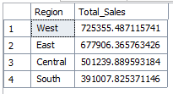
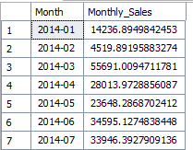

SQL INSIGHTS
Sales by Region
Monthly Sales Trend
Profit by Category
Threats

Slide 6
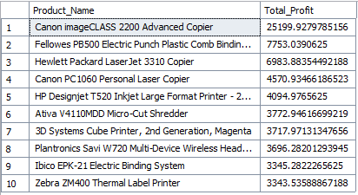
SQL INSIGHTS
Top 10 Profitable Products

Slide 7

DASHBOARD

Slide 8
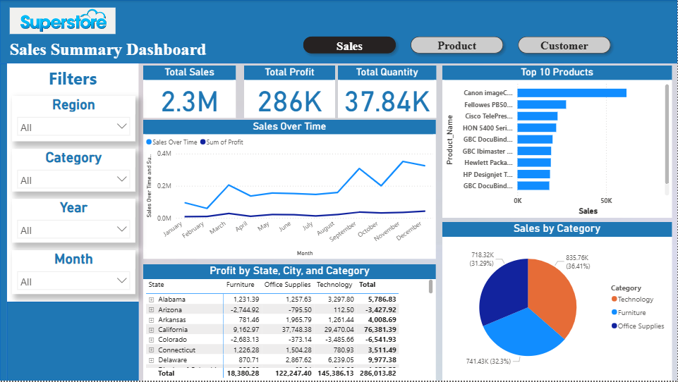

Slide 9
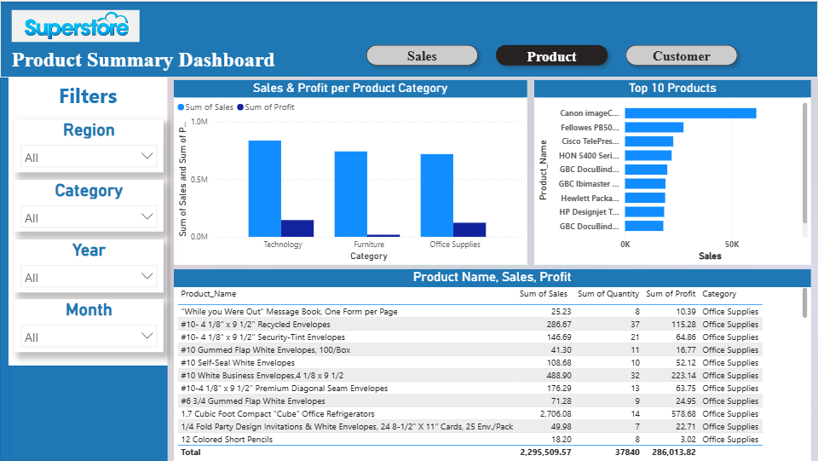

Slide 10
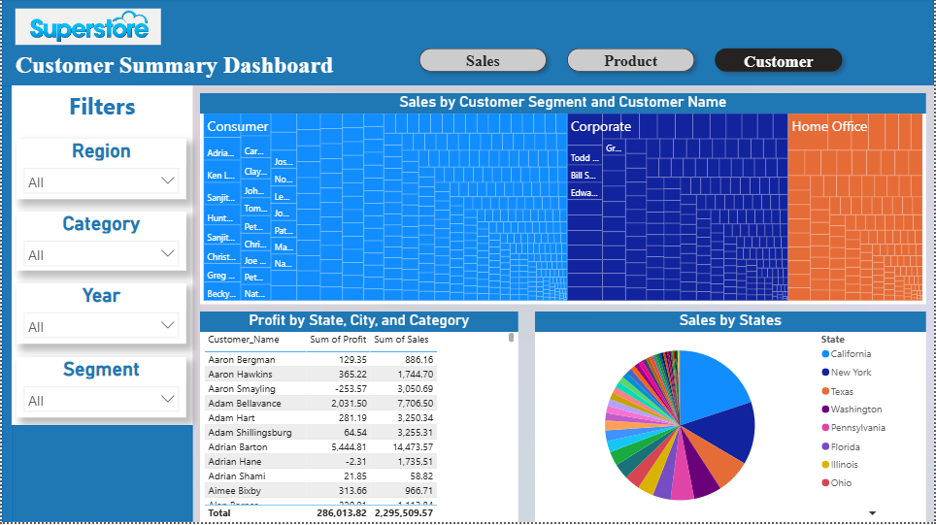

Slide 11

THANK YOU
FOR YOUR ATTENTION

